Slide 1

EVT build PCBA to DVT build PCBA change history

Slide 2
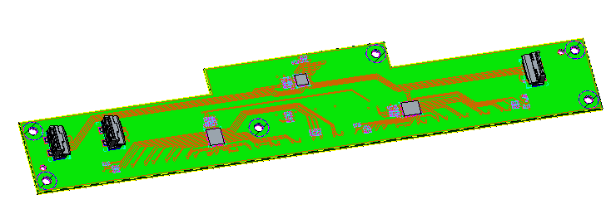
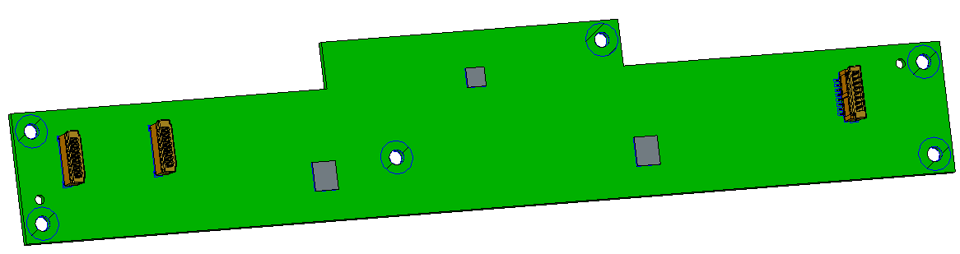
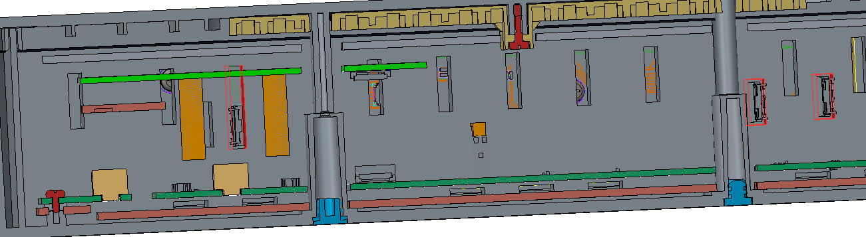
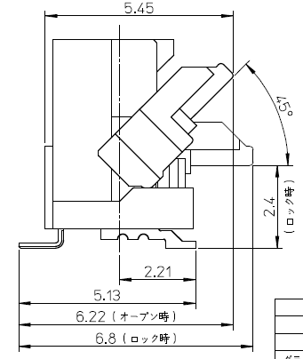
LED Board
Changing the cable connector to FCC connector which will interfere with bottom cover, and the bottom cover need to be modified.
Original PCBA
Current PCBA
Need to modify Bottom cover accordingly
FCC connector
Open status：Before assembling the FFC
Close status: After assembling the FFC

Slide 3
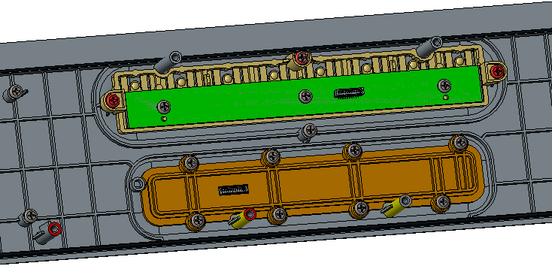
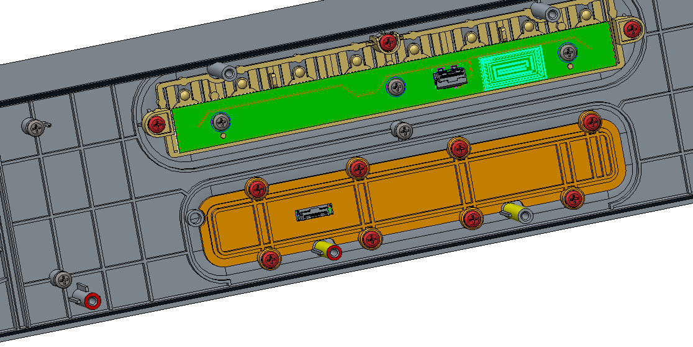
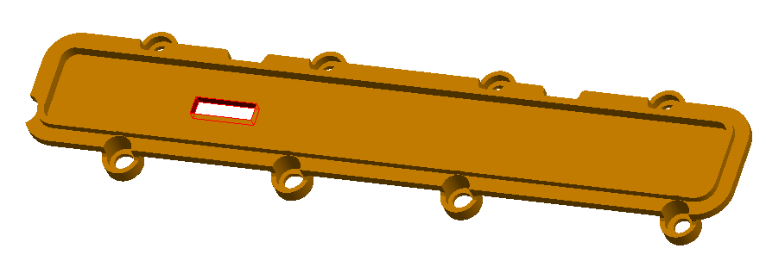
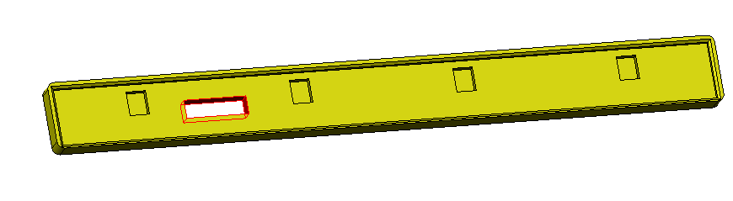
Button Board and Mic Board
Changing the cable connector to FCC connector on the Mic board which will interfere with mic-holder-part and silicon-mic, so the mic-holder-part and silicon-mic need to be modified.
Original PCBA
Current PCBA
Need to modify mic-holder-part and accordingly silicon-mic
Mic silicon part
Mic holder part

Slide 4
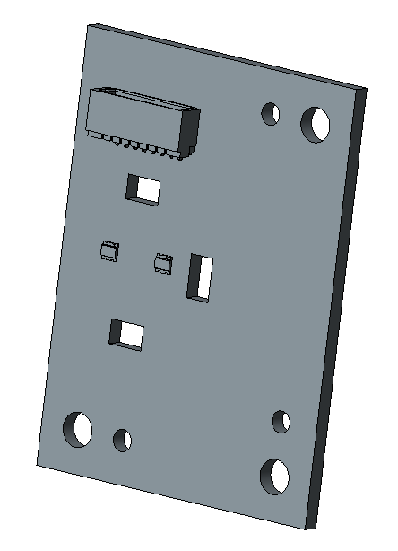
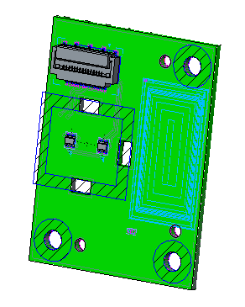
Side LED Board
Changing the cable connector to FCC connector on the Side LED Board.
Original PCBA
Current PCBA

Slide 5
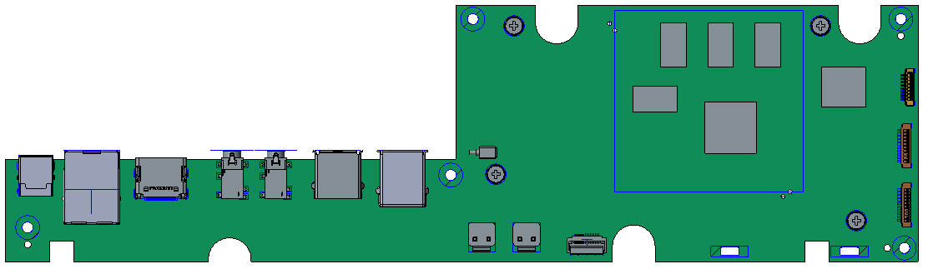
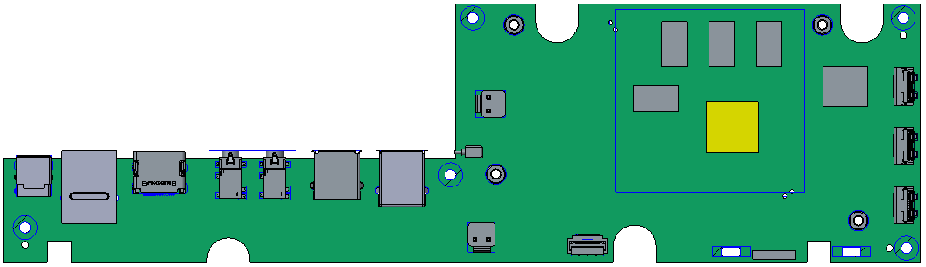
SoC Board
Changing the cable connector to FCC connector on the SoC Board and moving the position of some connectors.
Original PCBA
3mm
Current PCBA

Slide 6
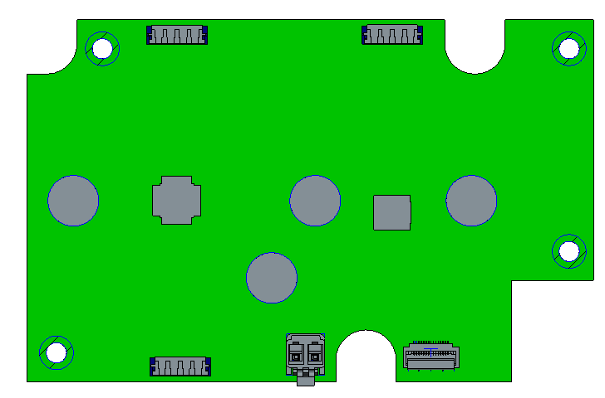
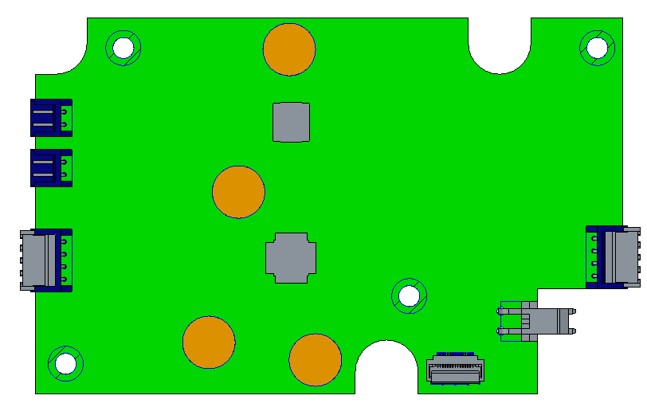
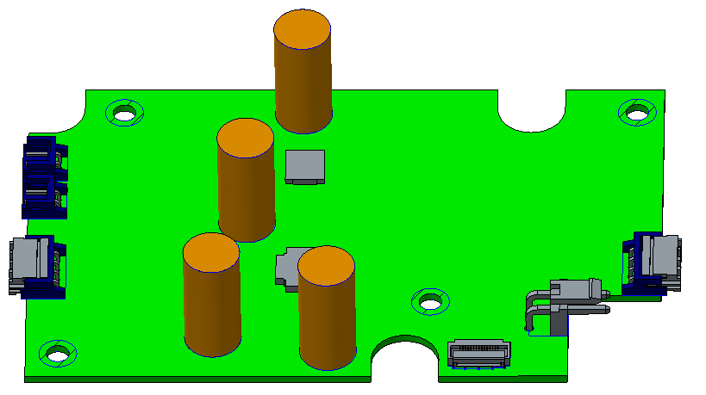
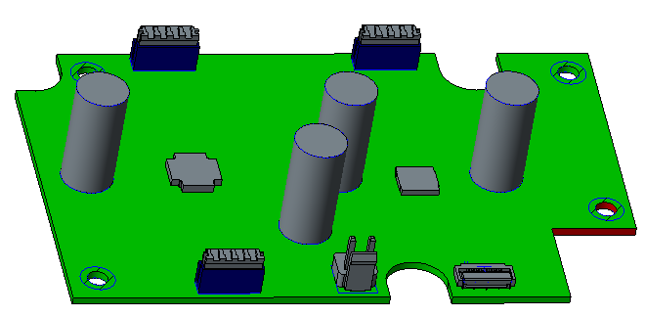
Amp Board
Moving the position of some connectors.
Original PCBA
Current PCBA

Slide 7
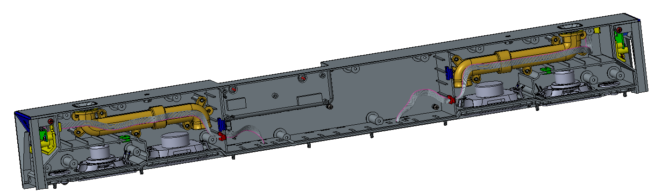
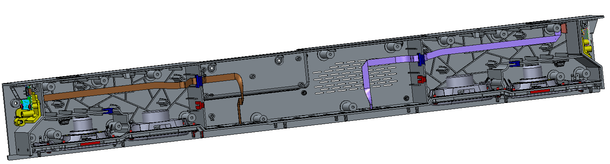
Cable routing
Side LED Board to LED board
Original cable
Current FFC cable

Slide 8
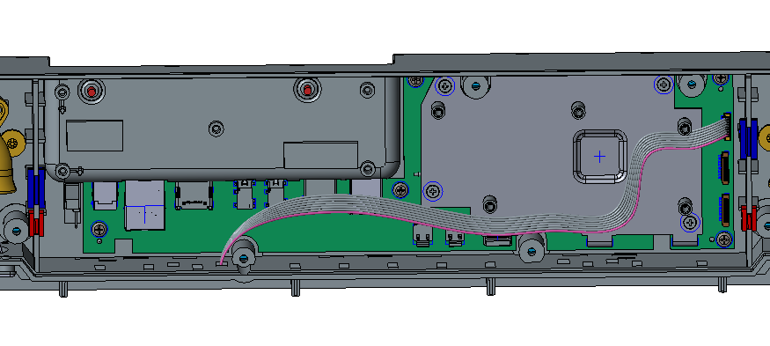
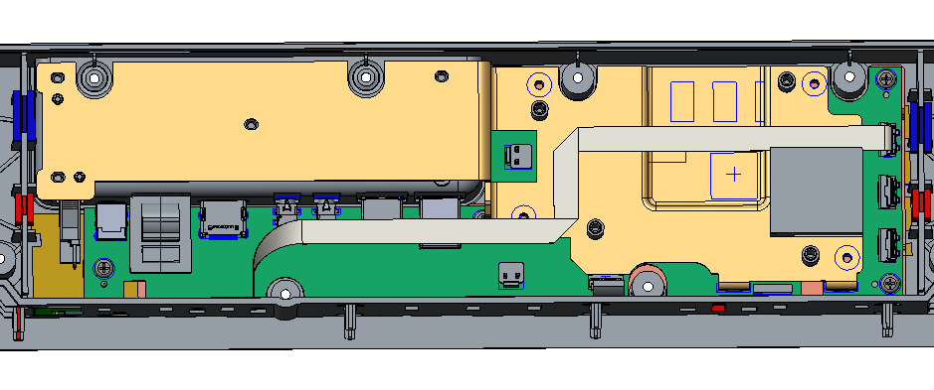
Cable routing
SoC Board to LED board
Original cable
Current FFC cable

Slide 9
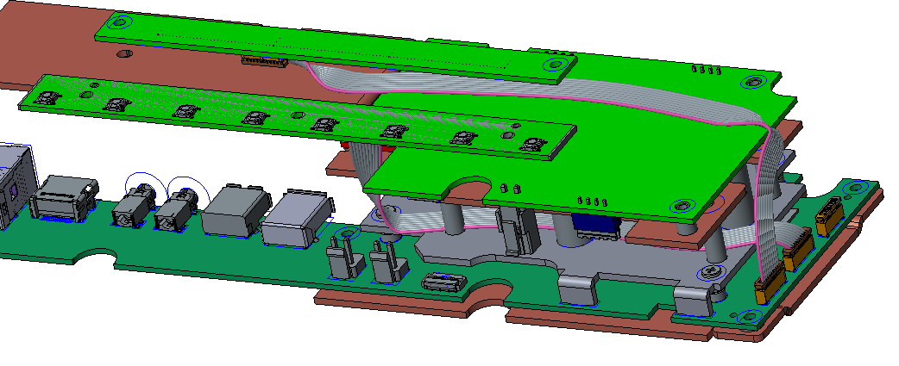
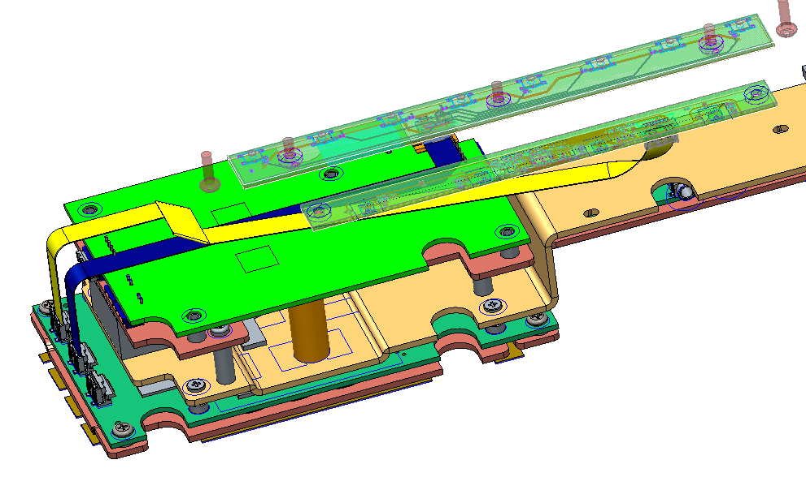
Cable routing
SoC Board to Button board and Mic board
Original cable
Current FFC cable

Slide 10
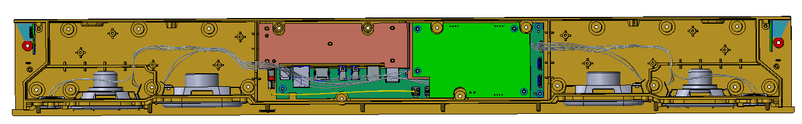
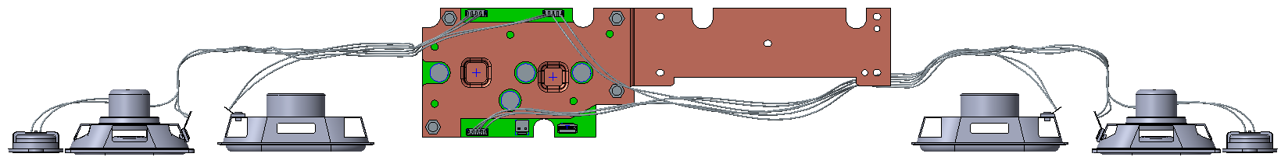
Cable routing
SPK to Amp board
Original Amp board
Bottom view
SPEAKER_CORD_ASSY_RIGHT
SPEAKER_CORD_ASSY_LEFT

Slide 11
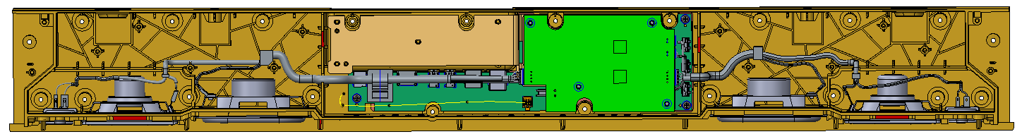
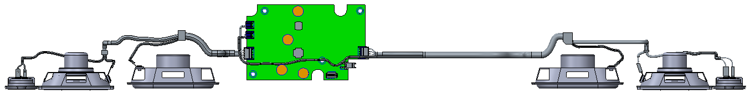
Current Amp board
Bottom view
SPEAKER_CORD_ASSY_RIGHT
SPEAKER_CORD_ASSY_LEFT

Slide 12
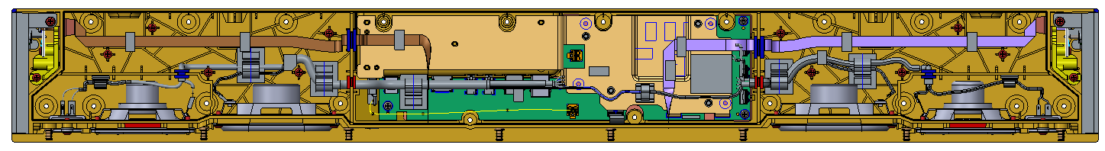
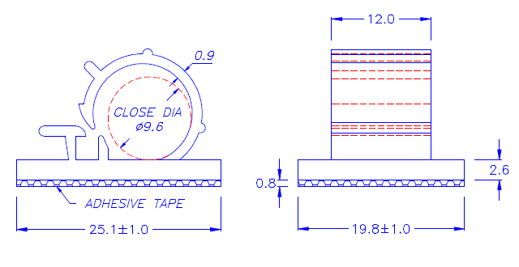
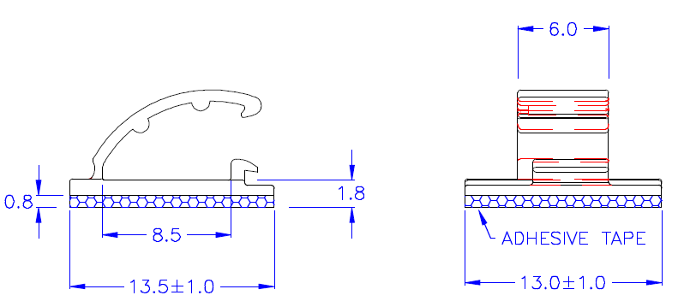
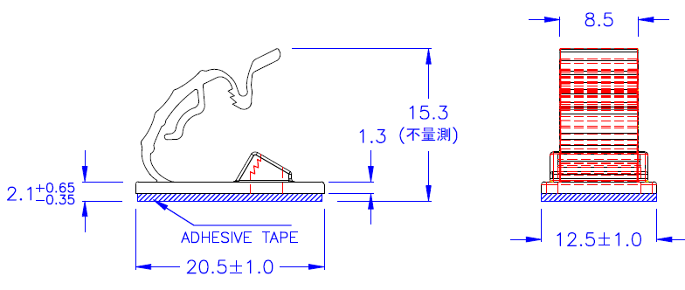
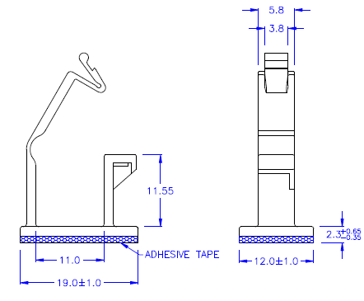
Cable assembly
OR

Slide 13
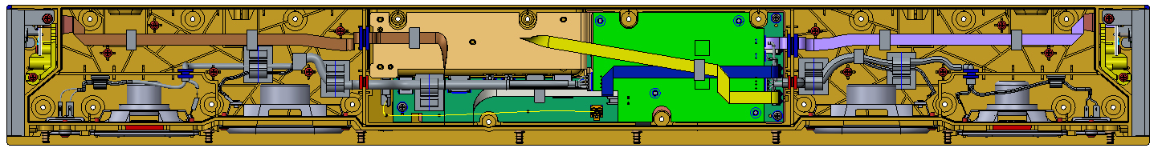
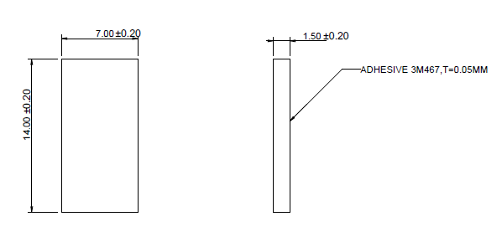
Cable assembly
Sponge for all FFC cable

